Slide 1
VARIATIONAL MODE DECOMPOSITION
From VMD to unfolded VMD
The ADMM solver, its deep-unfolded version UVMD (Ahmad et al., 2025), where it falls short in theory, and a three-dataset comparison at K = 13
Aitzaz · SPML group, Aarhus University · October 2026
Notes:
Plan: classic VMD, the idea of unfolding, UVMD in detail, theoretical caveats, then reconstruction and separation results on synthetic, CWRU and LargeST data.

Slide 2
What this talk covers
1
Classic VMD
The problem, the ADMM updates, how the loop runs
2
Deep unfolding
Iterations become layers, hyperparameters become weights
3
UVMD (Ahmad et al.)
Layer, trained parameters, training, paper versus code
4
Where it falls short
Theoretical caveats and how far ω moves in practice
5
Results
Reconstruction, then separation: synthetic, CWRU, LargeST

Slide 3
CLASSIC VMD
VMD: split a signal into K narrow-band modes
Reading the terms
CONSTRAINED PROBLEM
min over {u_k}, {ω_k}
Σ_k ‖ ∂t[(δ(t) + j/(πt)) ∗ u_k(t)] · e^(−jω_k t) ‖²
subject to Σ_k u_k = f
u_k: mode k, ω_k: its centre frequency
Hilbert term: makes u_k analytic, one-sided spectrum
e^(−jω_k t): shifts mode k to baseband
‖∂t ·‖²: the bandwidth of that shifted mode
Constraint: the modes must add up to f
Hyperparameters: number of modes K, bandwidth penalty α, dual step τ.
Notes:
VMD minimises the summed bandwidth of K modes, each centred on its own frequency, under the constraint that the modes reconstruct the signal exactly.

Slide 4
CLASSIC VMD
ADMM turns it into three closed-form updates
Mode update
û_k = ( f̂ − Σ_{i≠k} û_i + λ̂/2 ) / ( 1 + 2α(ω − ω_k)² )
Centre frequency
ω_k = ∫₀^∞ ω |û_k(ω)|² dω / ∫₀^∞ |û_k(ω)|² dω
Dual ascent
λ̂ ← λ̂ + τ ( f̂ − Σ_k û_k )
The mode update is a Wiener-like filter centred on ω_k; α sets how narrow it is
ω_k is the power-weighted mean frequency of the mode, positive half spectrum
All updates run in the FFT domain, so the method is global and non-causal
Notes:
Standard VMD (Dragomiretskiy and Zosso, 2014). In our benchmark tau is 0, so the multiplier stays at zero.

Slide 5
CLASSIC VMD
How the VMD loop runs
START
Initialise
ω_k on a uniform grid, û = 0, λ̂ = 0
STEP 1
Modes
Update û_k for k = 1..K, one after the other
STEP 2
Centres
ω_k from the mode’s power spectrum
STEP 3
Multiplier
Dual ascent on λ̂ with step τ
→
→
→
Repeat until the modes stop changing (tolerance) or the iteration cap is reached. Typically hundreds of FFT sweeps per signal.
K = 13
α = 2000
τ = 0
tol = 1e-7
max 499 iterations
DC mode, mirrored extension
Notes:
Settings in the pills are the ones used in this benchmark. The mode sweep is Gauss-Seidel.

Slide 6
DEEP UNFOLDING
Unfolding: an iterative algorithm becomes a network
ITERATIVE SOLVER
repeat n = 1..500:
x ← T(x; θ)
One operator T, one fixed θ (α, τ), many repetitions until convergence.
UNFOLDED NETWORK
x₁ = T(x₀; θ₁)
x₂ = T(x₁; θ₂)
… x_N = T(x_{N−1}; θ_N)
N copies (N small), each with its own learnable θ_n.
Each iteration becomes a layer; fixed depth N replaces “until convergence”
Hyperparameters become weights that gradient descent can tune
Origin: LISTA, which unfolded ISTA for sparse coding (Gregor and LeCun, 2010)
Notes:
The structure of the algorithm is kept, so the network stays interpretable: every layer is still one step of the original method.

Slide 7
DEEP UNFOLDING
How an unfolded algorithm is trained
1
Truncate
Keep N iterations, N = 1 or 2 here
2
Parametrise
Pick hyperparameters to learn, one set per layer
3
Define a loss
Score the output of the last layer
4
Backpropagate
Gradients flow through all layers; Adam updates the parameters
5
Fix and deploy
Freeze the weights, run N layers on new signals
TRADE
Speed for guarantees
Far fewer steps, but no convergence guarantee and tuned to the training data
Notes:
Training is end to end: the loss only sees the final layer, but its gradient reaches every layer’s parameters.

Slide 8
UVMD (AHMAD ET AL.)
UVMD: one layer is one VMD sweep
Input f
Mirror, FFT, keep the positive half: f̂₊
Layer 1
α_k, λ̂₁
Layer N
α_k, λ̂_N
Modes u_k
Inverse FFT; loss on Σ_k û_k
→
→
→
û_k = ( f̂₊ − Σ_{i≠k} û_i − λ̂_n/2 ) / ( 1 + softplus(α_k)(ω − ω_k)² )
ω_k = Σ ω |û_k|² / Σ |û_k|² (positive half, k ≥ 1)
Layer n sweeps through the K modes (Gauss-Seidel), then recomputes every ω_k from the new spectra. Mode 0 stays at DC. Written as in the released code.
Notes:
Source: Ahmad, Wesemann, Waschkowski, Khalid, arXiv 2509.00703, and the released code (OsamaAhmad369/MAGN, uvmd.py). The equation form is the code’s; the paper differs slightly.

Slide 9
UVMD (AHMAD ET AL.)
What UVMD trains, and what it does not
TRAINED
α_k, K values
• Bandwidth penalty per mode, through softplus
• Shared by all layers
• Initialised at 2000
TRAINED
λ̂_n, one per layer
• Complex vector of length 2T (T = signal length)
• Replaces the dual variable
• Initialised at 0
NOT TRAINED
ω_k
• Recomputed from û_k in every layer
• Starts on a fixed uniform grid, 0.5·k/K
• No weight of its own
Both trained parameters enter only the mode update. The frequency update has none, so ω can change only through û_k.
Notes:
The released code allocates N+1 rows for lambda; the last is never used. Alpha is one vector of K values reused in every layer.

Slide 10
UVMD (AHMAD ET AL.)
How UVMD is trained
Item | Setting
Loss | Spectral reconstruction error, Σ |Σ_k û_k − f̂₊| (L1 in the code, L2 in the paper)
Supervision | None: no ground-truth modes, the loss sees only the sum
Optimiser | Adam, learning rate 0.1, batch size 1
Schedule | Up to 100 epochs, early stopping with patience 10
Data split | 70 / 15 / 15, random_state 42
Model size | K = 13 modes, N = 1 or 2 layers
Initial values | α_k = 2000, λ̂ = 0, ω on the uniform grid
The learned α and λ̂ are shared by every signal of the dataset; they are not computed per signal.
Notes:
We use the upstream training loop unchanged. Upstream saves the best weights and then overwrites them with the last-epoch weights; the training loss was still falling at epoch 100.

Slide 11
UVMD (AHMAD ET AL.)
The paper and the released code differ
Item | Paper | Released code
Denominator | 1 + 2·softplus(α)(ω − ω_k)² | 1 + softplus(α)(ω − ω_k)²
Multiplier term | + λ̂/2 | − λ̂/2
Loss | L2 norm | L1, sum of absolute values
Problem statement | No constraint, no λ update given | λ̂ is a free trained tensor
The sign of λ̂ is absorbed by training, but the factor 2 changes what α means: the same number gives a different filter width
The headline “250× faster” is about 162× from the paper’s own timings
“Robust” is in the title, but no noise experiments are reported
The upstream repository carries no licence
Notes:
We use the released code unchanged as the reference implementation.

Slide 12
CAVEAT 1
The trained parameters never act on ω
α_k, λ̂
The only weights
û_k update
Filter width and offset
ω_k update
Mean frequency of û_k, no weight
→
→
ω can move only indirectly, through the spectrum that α and λ̂ shape
With N = 1 or 2 it is updated once or twice; classic VMD updates it hundreds of times
It starts on a uniform grid that need not match the signal’s true frequencies
Nothing in the loss pushes ω toward the right place
Notes:
Our measurements on the next slides show this holds on traffic and synthetic data, but not on CWRU.

Slide 13
CAVEAT 2
The loss rewards reconstruction only
λ̂ is a free complex vector of length 2T: it can absorb the residual and cut the error without making better modes
α can collapse: with α → 0 a mode passes everything and the sum is exact
No term asks for orthogonal or narrow-band modes
One α and λ̂ for the whole dataset; changing T means retraining
SEEN ON CWRU, 1 LAYER
Reconstruction error
0.0662 → 0.0004
Spectral overlap
0.066 → 0.371
Untrained VMD-1 to trained UVMD-1. One α went to 0.
Notes:
The CWRU result is the clearest case: near-perfect reconstruction with modes that overlap far more than the untrained ones.

Slide 14
FURTHER CAVEATS
Other limits to keep in mind
Far from the fixed point
1 or 2 sweeps cannot reach what 500 reach, so the output is not a VMD solution
Non-causal
A global FFT sees the whole window, so forecasting use risks leakage from the future
Fixed window length
λ̂ has length 2T, so a different T needs new training
Batch size 1
One signal per step, so a GPU helps little
Training bookkeeping
Best weights are saved, then overwritten by the last epoch; loss still falling at epoch 100
Not tuned for forecasting
The paper reports that more layers overfit

Slide 15
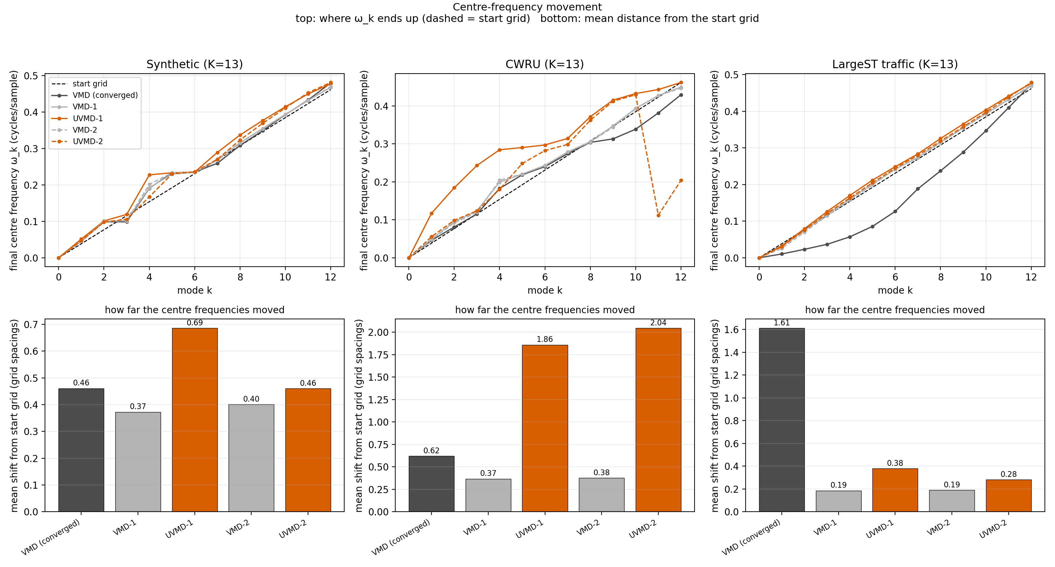
Does ω really barely move? Partly
Mean shift | VMD | UVMD-1 | UVMD-2
Synthetic | 0.46 | 0.69 | 0.46
CWRU | 0.62 | 1.86 | 2.05
Traffic | 1.61 | 0.38 | 0.28
Grid spacings from the start grid; VMD is the converged run.
Traffic and synthetic: UVMD moves ω little, as predicted
CWRU: UVMD moves it 3× more than converged VMD
Moving more is not moving right: synthetic centre-frequency error is 0.0025 for UVMD-1 against 0.0011 for VMD
Notes:
Shift is in grid spacings of 0.5/K cycles per sample, averaged over modes 1 to K-1 and over test signals. Converged VMD is computed on 10 signals.

Slide 16
RESULTS
Experimental setup
Synthetic
4 known modes, ground truth available, 30 test signals
CWRU bearing
Vibration with fault lines, 300 test signals
LargeST traffic
San Diego sensors, bounded run, 30 test windows
Methods, all at K = 13: converged VMD; VMD-N (VMD stopped after N iterations); trained UVMD-N with N = 1, 2.
VMD-N equals UVMD-N before training, so the pair isolates the effect of training.
Reconstruction: relative error ‖x − Σu_k‖ / ‖x‖.
Separation, without ground truth: orthogonality index, spectral overlap, relative bandwidth, energy ratio, with the effective number of modes as a guard.
Notes:
The traffic run uses 100 training, 20 validation and 30 test nodes; the full protocol has not been run.

Slide 17
RESULTS
Reconstruction: trained UVMD wins
Relative error ↓ | VMD converged | VMD-1 | UVMD-1 | VMD-2 | UVMD-2
Synthetic | 0.0294 | 0.0499 | 0.0066 | 0.0379 | 0.0142
CWRU | 0.0760 | 0.0662 | 0.0004 | 0.1070 | 0.0004
LargeST traffic | 0.0303 | 0.0729 | 0.0205 | 0.0838 | 0.0372
Trained UVMD-N beats untrained VMD-N on 100% of signals in every dataset and for both depths
One trained layer also beats converged VMD on all three datasets
Exception: on traffic, UVMD-2 (0.0372) is slightly worse than converged VMD (0.0303)
Notes:
Mean over test signals. Bold marks the best entry of each row (tie on CWRU).

Slide 18
RESULTS
How much training cuts the error
Trained UVMD-N error divided by untrained VMD-N error, same depth. Lower is better.
Synthetic
0.13×
1 layer
0.38×
2 layers
CWRU
0.01×
1 layer
<0.01×
2 layers
LargeST traffic
0.28×
1 layer
0.44×
2 layers
The gain is largest where the loss can be gamed most easily (CWRU, with one α driven to 0). Read these numbers together with the separation results.
Notes:
Ratios of means from Table A2. CWRU 2 layers is 0.00 in the table, below rounding precision.

Slide 19
RESULTS
How separation is measured without ground truth
Criterion | What it measures | Better
Orthogonality index | Σ_{i<j} |⟨u_i, u_j⟩| / ‖x‖², content shared between modes | lower
Spectral overlap | Share of spectrum two modes occupy together | lower
Relative bandwidth | Energy-weighted spectral width of a mode ÷ Nyquist | lower
Energy ratio | Σ‖u_k‖² / ‖x‖²; above 1 double counts, below 1 loses energy | closer to 1
Effective modes | 1 / Σ s_k², s_k the energy share of mode k; a guard, not a score | not near 1
On the synthetic data, where true modes are known, relative bandwidth tracks true separation best (Spearman −0.85), orthogonality and overlap about −0.5. Reconstruction error points the wrong way (+0.52).
Notes:
Spearman correlation against grouped mode SNR over 150 points (30 signals by 5 methods). The energy ratio showed no relation (-0.14).

Slide 20
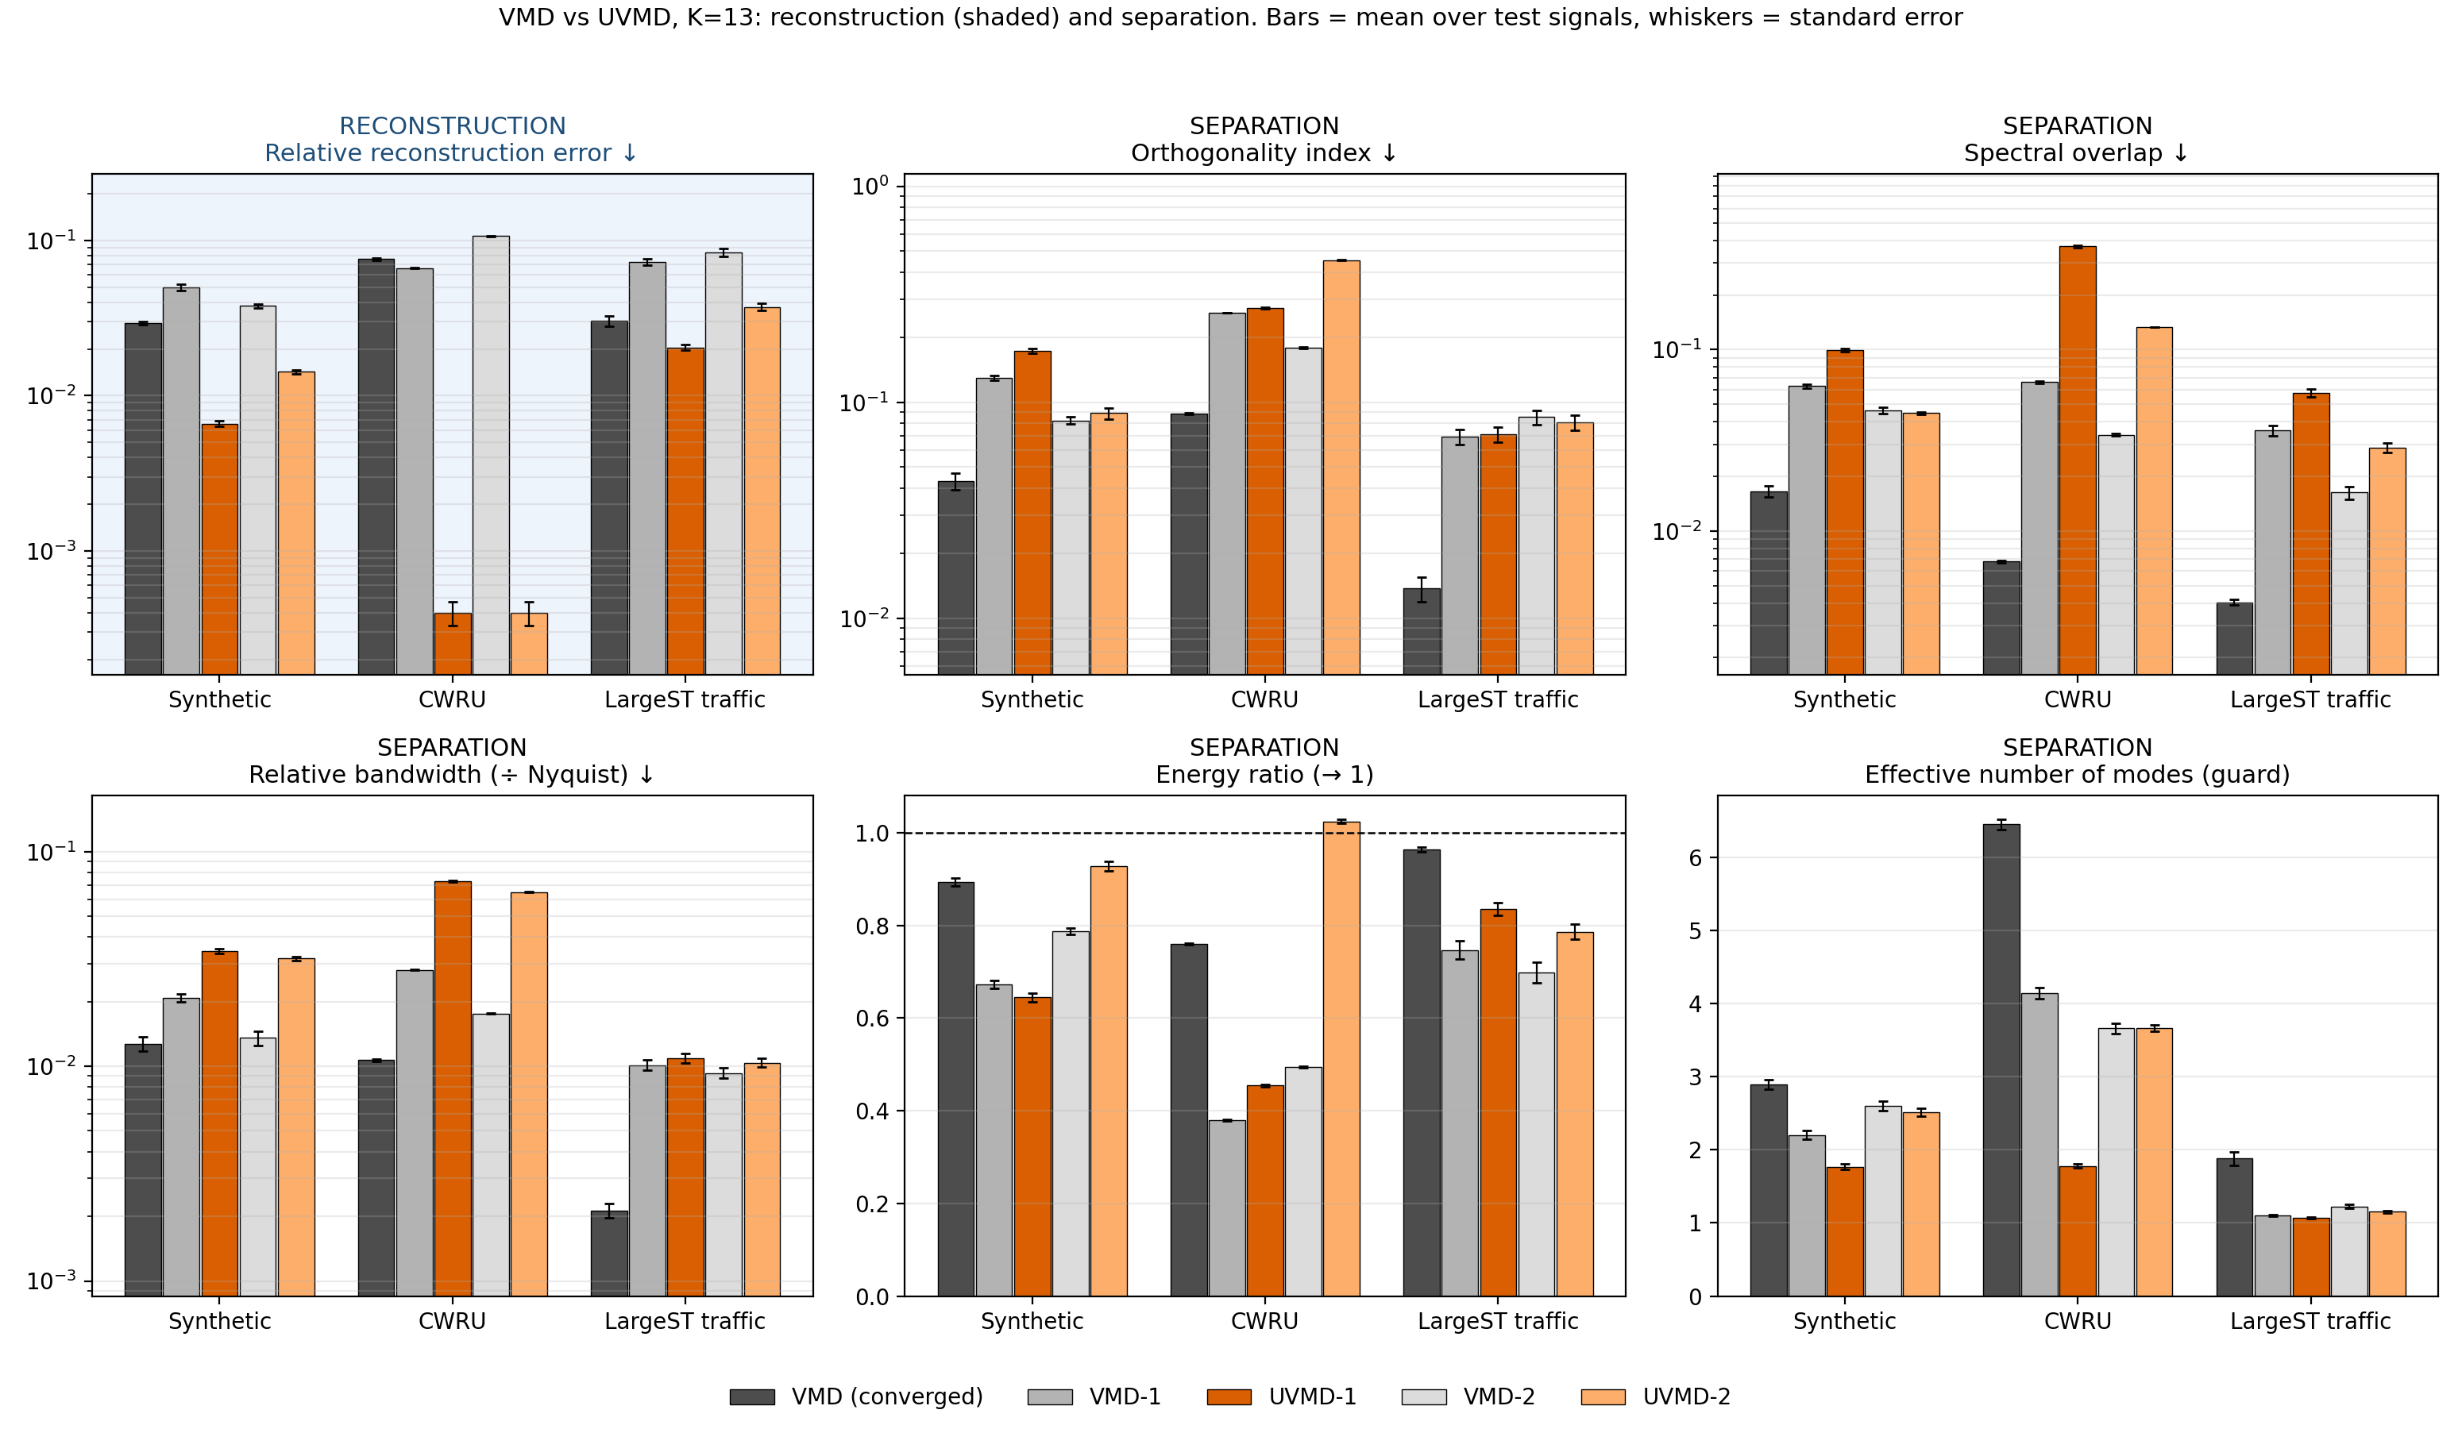
RESULTS
Separation: training does not help
Converged VMD is best on orthogonality, overlap and bandwidth in all three datasets
Trained UVMD-1 never beats VMD-1 on bandwidth (0% of signals): 1.65× synthetic, 2.59× CWRU, 1.08× traffic
Overlap is worse after training in five of six dataset and depth pairs, level in the sixth
Energy ratio is the one criterion that improves
Notes:
Lower is better for orthogonality, overlap and bandwidth. Ratios are trained UVMD-1 over untrained VMD-1 from Table A2.

Slide 21
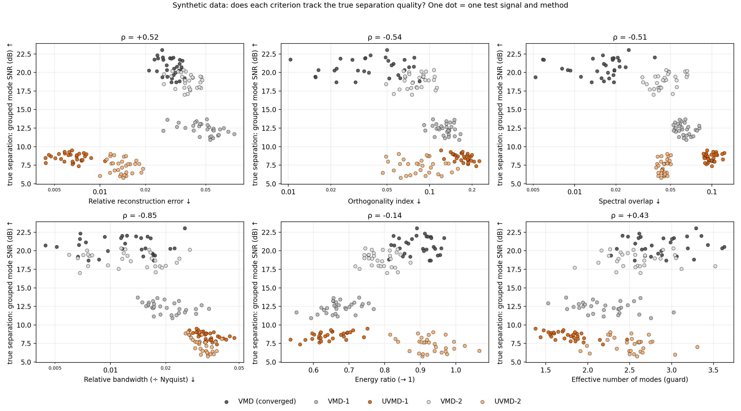
RESULTS
Synthetic data: separation against the true modes
Method | Mode SNR (dB) ↑ | Freq. error ↓
VMD converged | 20.7 | 0.00106
VMD-1 | 12.4 | 0.00120
UVMD-1 | 8.5 | 0.00252
VMD-2 | 18.8 | 0.00090
UVMD-2 | 7.3 | 0.00207
Training lowers the true mode SNR by 4 to 12 dB while reconstruction error falls by a factor of 2.7 to 7.6. Centre frequencies get farther from the truth.
Notes:
Grouped mode SNR: each estimated mode is assigned to the true mode it projects onto most, and the assigned modes are summed. Frequency error is in cycles per sample.

Slide 22
Conclusions and next steps
WHAT WE FOUND
NEXT STEPS
UVMD reconstructs better than VMD at the same depth on every signal, with 1 or 2 layers instead of hundreds of iterations
It does not separate better: at best on par with untrained VMD-N, below converged VMD
Reconstruction error is no evidence of separation
ω barely moves on traffic and synthetic, but moves a lot on CWRU
Add a separation term (bandwidth or orthogonality) to the loss
Give ω a trainable path: learned initial grid or a filter on the spectrum
Ablate: train α only, then λ̂ only
Test on forecasting with causal windows
Run the full traffic protocol
Traffic results come from a bounded run (100 / 20 / 30 nodes). Code, tables and figures: repository vmd-uvmd-comparison.
Notes:
The next-step ideas are proposals, not results.

